Slide 1
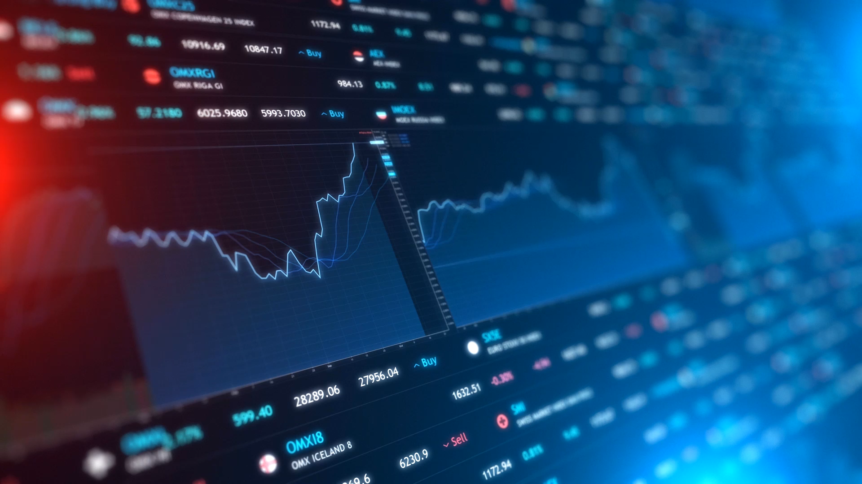
WallStreetBets Stock Sentiment Analysis
Bishes Limbu
Supervisor: Anne Hsu

Slide 2

Project Objectives
To research about meme stocks
To investigate the influence of social media on stock market trading
Market research on current available applications
To investigate and explore current tools and apps for sentiment analysis
To develop a web app using Django back-end

Slide 3
Literature Review Findings and Problem Investigated
“Facts only account for 10% of the reactions on the stock market; everything else is psychology.” - Andre Kostolany (Nasdaq, 2019))

Slide 4

Influence of Social Media on the Stock Market

Slide 5

WallStreetBets Investing vs Traditional Long-Term Investing
On average WSB portfolio stocks have grown 3-4 times more than traditional long-term trading through the S%P 500

Slide 6
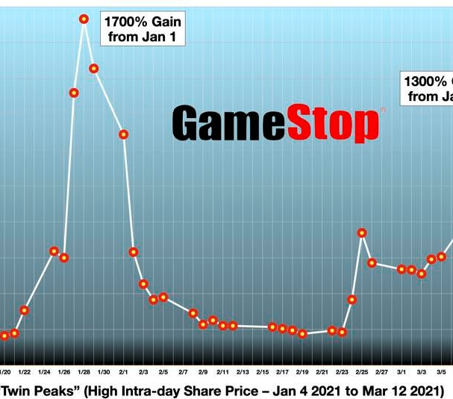
GME Meme Stock Case Study
95% change in value.
Movement started by Keith Gill ‘RoaringKitten’

Slide 7
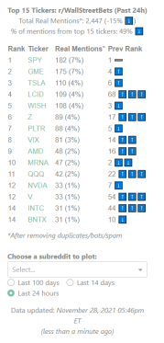
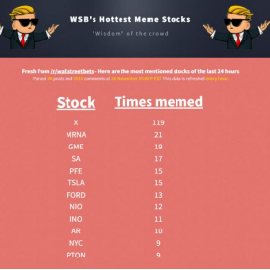
Market Research
Not many applications like this available

Slide 8
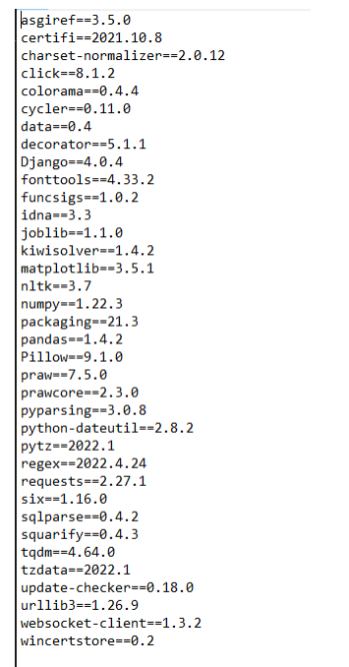
Technology Research
Python
PRAW
Twitter API
Matplotlib
Pandas

Slide 9
Project Aims
Produce a Model to train it for Sentiment Analysis
1
Web Application that scrapes Reddit and Twitter for data
2
Web Application will give a sentiment score, assigning the data into Bullish, Neutral or Bearish. Effectively, predicting what the price movement will be.
3

Slide 10
Implementation of Solution

Slide 11
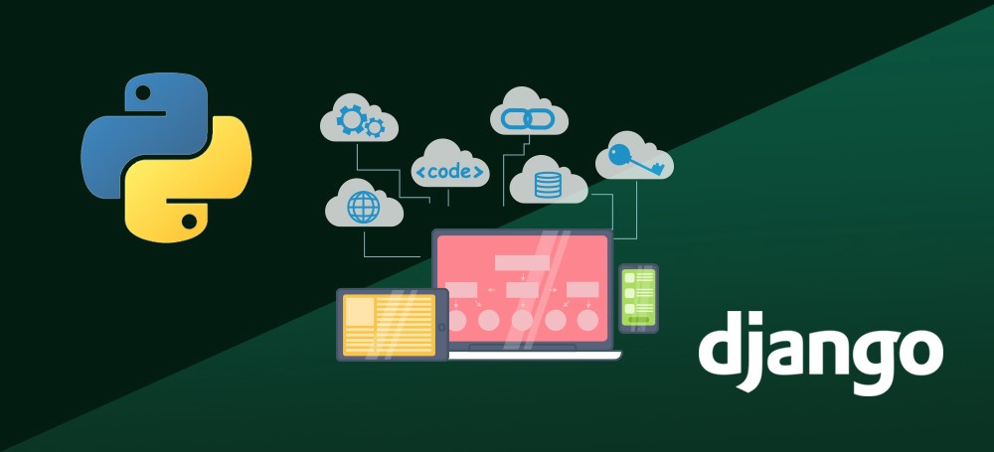
Django Backbone
Django, backend, using views and urls to produce the webpages required.

Slide 12
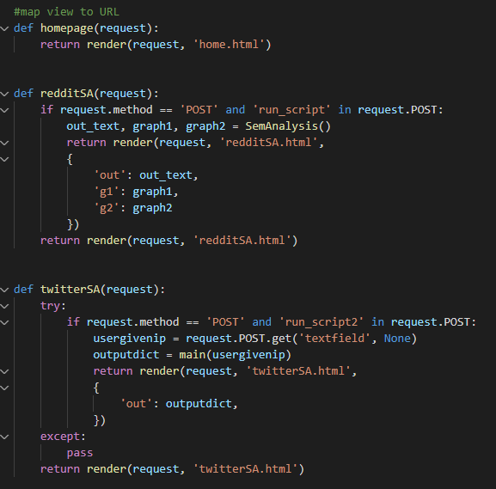
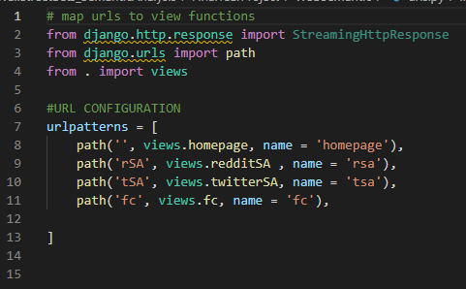

Slide 13
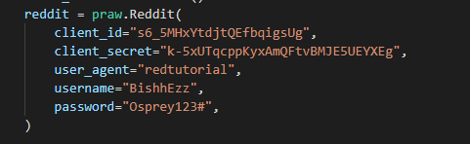
The Python Reddit API Wrapper (PRAW)
Scrape reddit for data
Scrape the comments and use for sentiment analysis

Slide 14
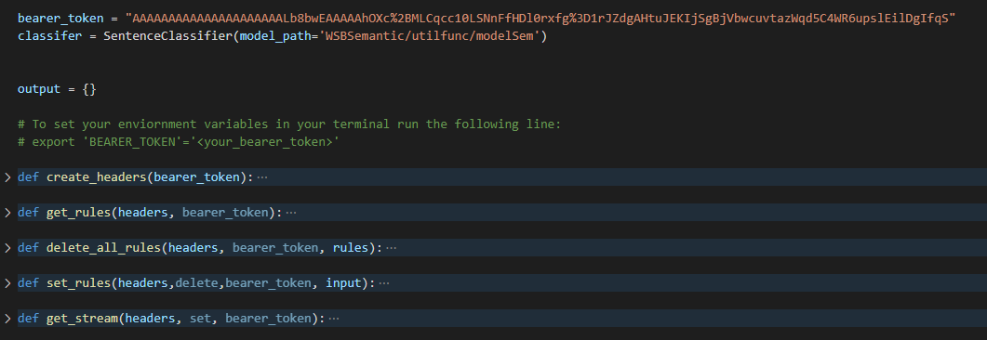
Twitter API

Slide 15

Creating the Model using BERT
BERT (Bidirectional Encoder Representations from Transformers) a pre-existing model on the English language is imported into the program.
BERT is trained using a new dataset which was created from stock/financial tweets from a live twitter stream.

Slide 16
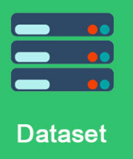
Creating the dataset

Slide 17
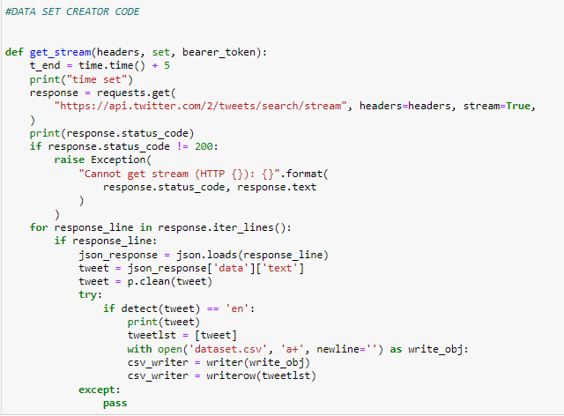
Preprocessing Twitter Stream/Creating Dataset
Using LangDetect and Preprocesser module

Slide 18
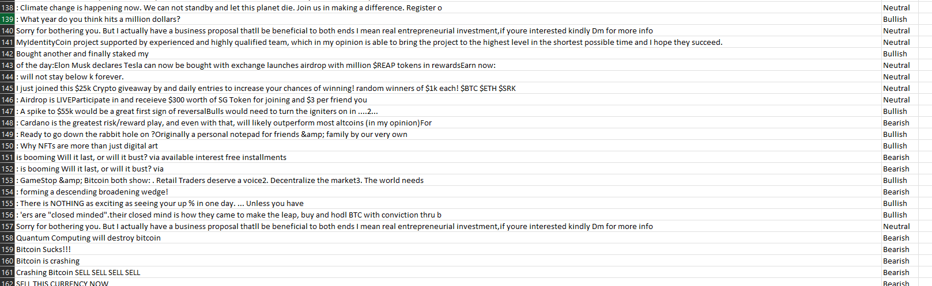
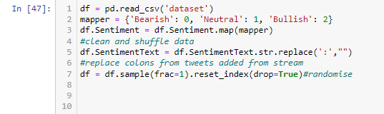
Processing Dataset

Slide 19
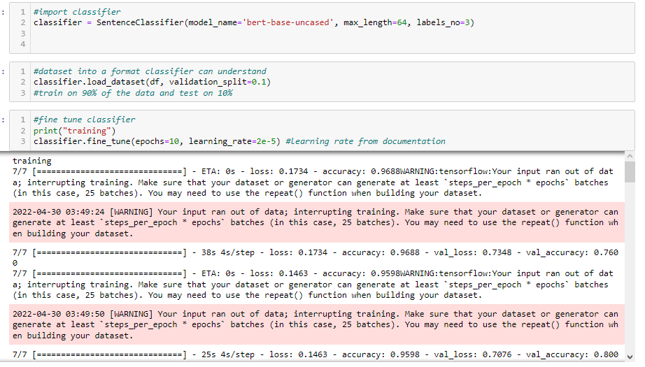
Fine tuning the model / training the dataset

Slide 20
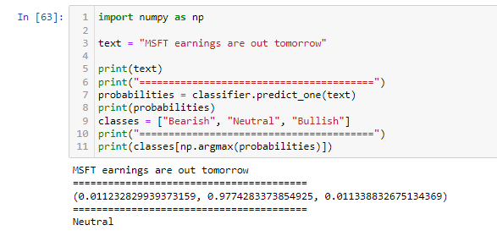
Predicting new text

Slide 21

Importing to webapp
Export it as a file
Django Backend can access

Slide 22
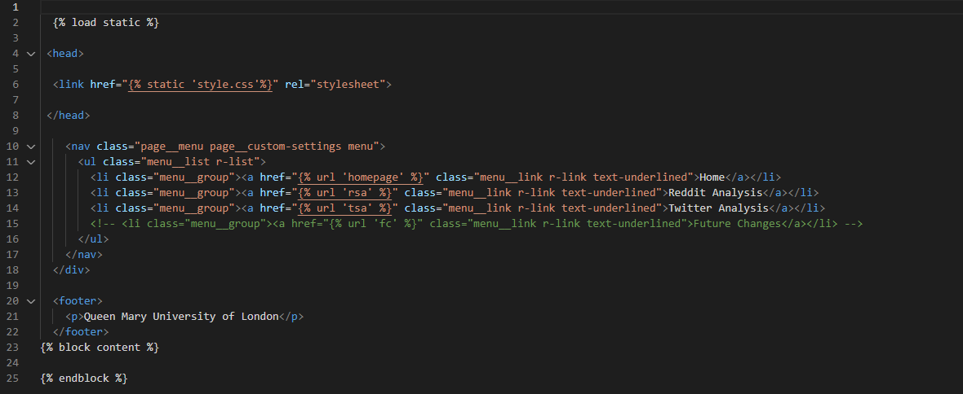
HTML Pages
Django template language
Django base template

Slide 23
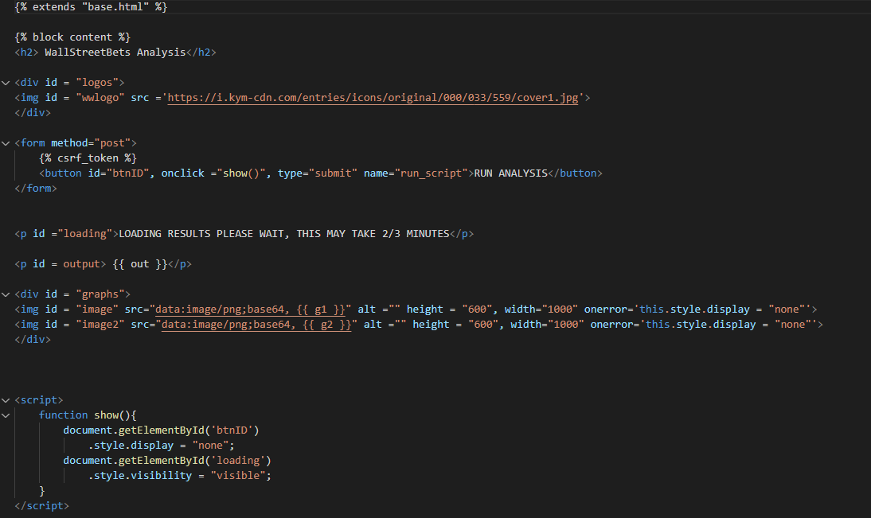
JavaScript + Triggering Scripts

Slide 24
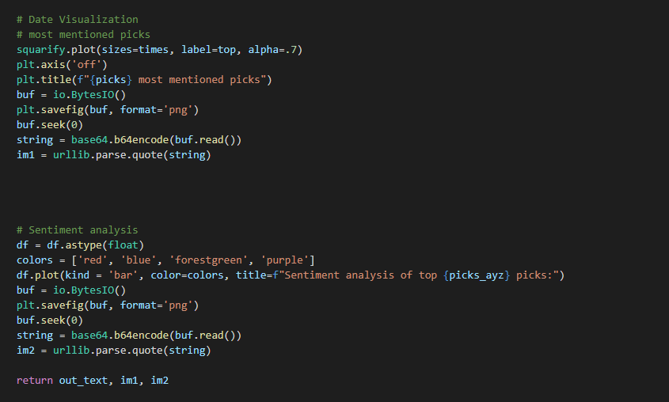
Reddit Analysis

Slide 25
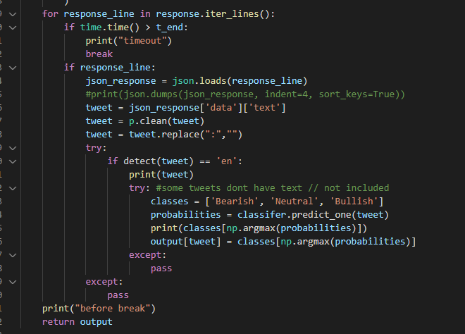
Twitter Analysis

Slide 26
DEMO

Slide 27
Problems Encountered
Finance API
Lack of time for testing
Time Management
Lack of Knowledge

Slide 28

Evaluation through testing

Slide 29
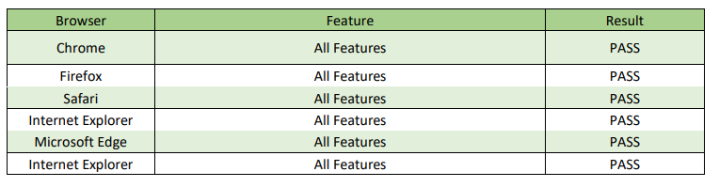
Browser Compatibility

Slide 30
User Testing
“The app is incredibly easy to use, all you have to do is click a button or type then click a button. It provides decent analytics and gives an overall noise that is currently around a certain stock. Like it showed how everyone is very pessimistic right now due to the volatility of the market and shows how every stock is red. I’d like to see users being able to change the values for the reddit analytics though. Because on somedays I want to check more stocks, to see if they are a good investing opportunity.”

Slide 31
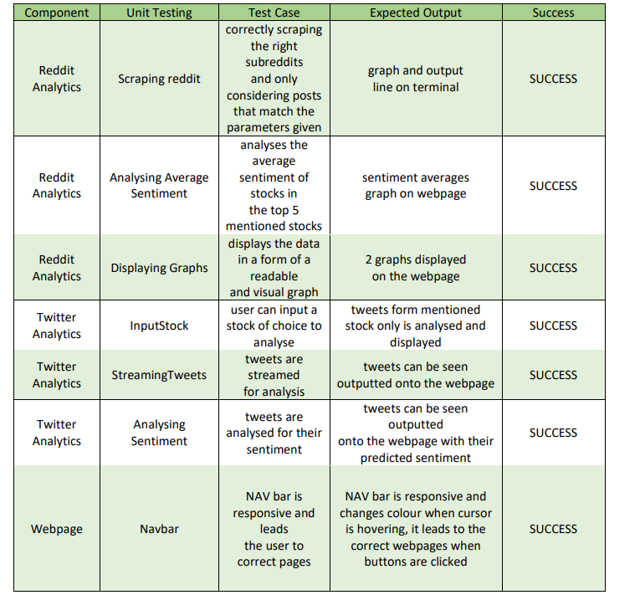
Unit Testing

Slide 32
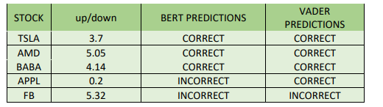
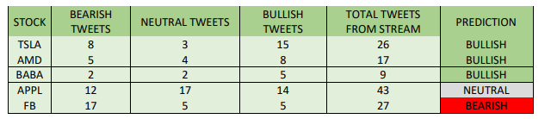
Prediction Testing
Weekend Predictions for trading Monday
Lack of time/testing done.

Slide 33
Future Improvements
Increase time-frame for testing
Increase the dataset
Expanded into more programs such as a trading bot
Can scrape financial articles.

Slide 34
References
Nasdaq, 2019. How Does Social Media Influence Financial Markets?. [Online] Available at: https://www.nasdaq.com/articles/how-does-social-media-influence-financial-markets2019-10-14 [Accessed 28 11 2021].
Service, B. N., 2021. Social stock: how social media and influencers affect financial markets. [Online] Available at: https://bunewsservice.com/social-stock-how-social-media-and-influencers-affectfinancial-markets/ [Accessed 28 11 2021].
Venkata Sasank Pagolu, K. N. R. G. P. B. M., 2017. Sentiment analysis of Twitter data for predicting stock market movements. [Online] Available at: https://ieeexplore.ieee.org/abstract/document/7955659?casa_token=3WT2WEKzZTAAAAAA:qPEep UxYbkme9zo8EOWQVIykqtKOLB4gmzZl4Qd3ha2Pf09rvLp6aQS2wZAOvpn17wsNz0Uw [Accessed 28 11 2021].

